Slide 1
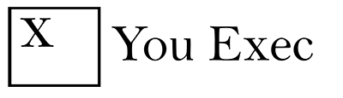
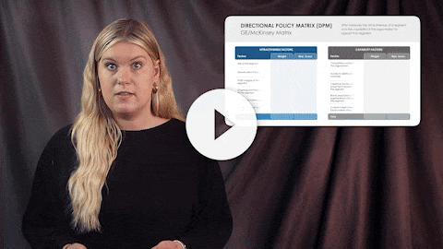
You Exec provides business resources that move your career forward. Access our full library of presentations, spreadsheet models, and business book summaries. We do the work, you take the credit.
Errors & Omissions Liability (E&O): You Exec makes no guarantee that the statements, analysis, projections, estimates, graphs, reports, numbers, and any derivatives sourced from this presentation are free of errors and omissions. You Exec assumes no liability for erroneous outcomes derived from this presentation.
Watch explainer
This video will walk you through the benefits of this framework. Paid members, please log in for a better viewing experience.
Found an error, have suggestions?
Feedback

Slide 2
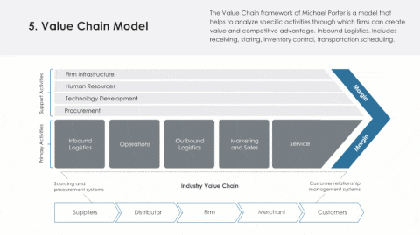
This presentation is Part 4 of the Business Strategies & Frameworks collection. Visit your dashboard or click on the download button on this slide to access other parts of this collection.
Download Part 1

Slide 3
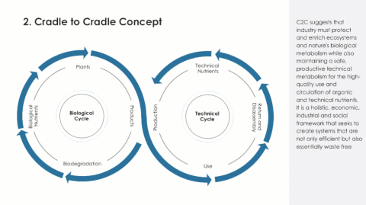
This presentation is Part 4 of the Business Strategies & Frameworks collection. Visit your dashboard or click on the download button on this slide to access other parts of this collection.
Download Part 2

Slide 4
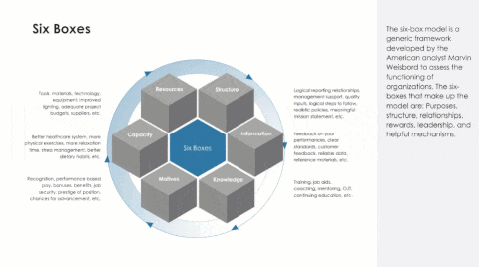
This presentation is Part 4 of the Business Strategies & Frameworks collection. Visit your dashboard or click on the download button on this slide to access other parts of this collection.
Download Part 3

Slide 5
DPM measures the attractiveness of a segment and the capability of the organization to support that segment.
DIRECTIONAL POLICY MATRIX (DPM)
GE/McKinsey Matrix
ATTRACTIVENESS FACTORS
CAPABILITY FACTORS
Factors
Weight
Max. Score
Factors
Weight
Max. Score
Size of the segment | 0.2 | 10
Growth rate of the segment | 0.4 | 18
Profit margins of the segment | 0.1 | 5
Ongoing purchasing power of the segment | 0.1 | 5
Attainable market share | 0.1 | 5
Required market share to break even | 0.1 | 5
Competitive capability of the organization | 0.3 | 14
Access to distribution channels | 0.3 | 14
Capital & human resource investment required to serve the segment | 0.2 | 10
Brand association of the organization in the eyes of the segment | 0.1 | 5
Current market share/likely future market share | 0.1 | 5
Total
1.0
48
Total
1.0
48

Slide 6
DIRECTIONAL POLICY MATRIX (DPM)
DPM categorizes and prioritizes opportunities. It can be customized to unique content and made relevant to the individual strategic position of the company in its marketplace.
The grid plots “market attractiveness” against “business strength” and allows management to prioritize resources accordingly.
Competitive Capability
Attractiveness

Slide 7
MCKINSEY’S 7 DEGREES OF STRATEGIC FREEDOM:
OPPORTUNITY PIPELINE
1
Maximizing existing customer
Sample text
Sample text
2
Attracting new customer
Sample text
Sample text
Sample text
3
Innovation of product & services
Sample text
Sample text
Sample text
Sample text
Sample text
Innovation of
value-delivery system
Sample text
4
Sample text
Sample text
Sample text
Improving industry structure
5
Sample text
Sample text
Sample text
Geographical expansion
6
Sample text
Stepping out into new business arenas
7

Slide 8
Used to develop ideas on where else to expand product sales to drive further growth. Developed by consultants at McKinsey, the tool helps business leaders identify which opportunities will contribute the greatest to further expansion.
MCKINSEY’S 7 DEGREES OF STRATEGIC FREEDOM
GROWTH STRATEGY
FOCUS
KEY STRATEGIES
New competitive arenas
How will you diversify opportunities?
Enter strategy here
High
New industry structure
How will you create new alliances and acquisitions to grow business?
Enter strategy here
New geographies
How will you move into new geographic markets?
Enter strategy here
Value delivery
How will you improve delivery of your product?
Enter strategy here
Challenge level
New products
What new products/services you could introduce?
Enter strategy here
Grow existing products
How will you continue to grow existing products?
Enter strategy here
Low
Maximize existing customers
How will you sell more of your products to existing customers?
Enter strategy here

Slide 9
PROFITABILITY FRAMEWORK
Digital Product
# of people with any fitness app installed
# of people with the app installed
x
# of users
# of those who have OUR fitness app
x
% that have used the app
Revenues
x
From paying users
% of users that pay
Revenue per paying user
=
x
Revenue per User
+
From non-paying users
% of users that don’t
Revenue per non-paying user
=
x
Profits
Software development costs
-
Fixed Costs
Content Development Costs
+
Server Infrastructure
Costs
Commissions to app platforms
Variable
+
User acquisition costs

Slide 10
PROFITABILITY FRAMEWORK
Physical Product
Price Per Unit
$1
Revenues
900
# of Units Sold
900
Profits
Cost Per Unit
-100
$0.33
Variable Costs
300
Costs
Units Produced
1,000
900
Fixed Costs
700

Slide 11
MARKET ENTRY ASSESSMENT
Range of performance that customers can utilize
When aiming for differentiation and growth, the best opportunity is to identify solutions that customers need and want.
Being on the leading edge of emerging trends and overcoming customer pain points disrupt the category and accelerates growth.
High
Unmet Needs
Pace of Technological Progress
Performance
Low
1980
1990
2000
2010
Time

Slide 12
COMPETITIVE BENCHMARKING
Customer’s Evaluation of Company
Customer’s Evaluation of Competitors
Weight
Competitor A
Competitor B
Competitor C
Competitor D
Critical
Success Factor
5
4
3
2
1
5
4
3
2
1
5
4
3
2
1
5
4
3
2
1
5
4
3
2
1
Technology
Quality
Order Processing
Service
Price
Employee Skills
Achievement
Internationality
Image
Advertising

Slide 13
BIA predicts the consequences of disruption of a business function and process and gathers information needed to develop recovery strategies. Potential loss scenarios should be identified during a risk assessment.
BUSINESS IMPACT ANALYSIS (BIA)
Business Function | Total Dependencies | Customer Impact | Financial Impact | Legal Impact | Resources Impact | Recovery Point Objectives | Recovery Time Objectives | Maximum Allowable Downtime | Overall Priority
Back office | 27 | High | Medium | Medium | High | 24 Hours | 24 Hours | 72 Hours | 1
Retail | 18 | High | Medium | Medium | Extreme | 24 Hours | 48 Hours | 72 Hours | 2
Customer service | 10 | High | Medium | Minimal | Low | 48 Hours | 12 Hours | 24 Hours | 3

Slide 14
S
Situation
Explain the situation you faced.
Selling business strategy, life coaching course & leadership masterminds
Existing client in a dead account
Existing client were leaving radio for other marketing methods
STAR FRAMEWORK
T
Task
Explain the task of what you had to do. Focus on your responsibilities.
Pre-sales phone sales, in-person event sales
Find ways to revitalize account
Research past behavior, connect w point of contact, find other solutions
The STAR method is a structured manner of responding to a behavioral-based question by discussing the specific situation, task, action, and result of the situation you are describing.
A
Action
Explain the actions you took to overcome the challenge you were faced with.
Address money concerns (drift programs – and revenue tiers)
Connected with stakeholders, reviewed past projects
Presented digital solutions that solve their problems.
R
Result
Explain the results of your actions, What did you learn?
Adapted sales cycle based on need, client priorities, budget
Leadership was loking for a way to change tech from past project
Gained their business on the digital side to make up for lost business

Slide 15
A
B
Key facts on the external & internal environment (Competitors, industry, IT, Public sector etc.)
System in focus (Area of work team is responsible for)
Design challenges (Issues affecting business)
Develop the “Focusing Question” (what is the question we are going to answer)
To have target customer segments seek to do business with us as their preferred company
To deliver above industry financial results to enable continued investment in the business and improved returns for shareholders
To add value in the community by giving peace of mind in turbulent times
Where are we now?
Where do we want to be?
The hypothesis or proposition for change, expressed as a sentence
Under sentence identify 3-4 discreet areas of action, e.g. Marketing, Financial, Skills, Systems etc.
C
How do we get there?
Activities that will make the ‘C’ happen
No more than 5 or 6
Need to be specific and measurable
Requires right resources & level of authority
D
How do we make this happen?
The AcdB planning model is a strategic development and planning tool to bridge the gap between A (current state) and B (future state) by identifying C (key themes) and D (actions /initiatives)
AcdB ANALYSIS

Slide 16





STAKEHOLDER ANALYSIS
A stakeholder analysis is a process of identifying these people before the project begins; grouping them according to their levels of participation, interest, and influence in the project; and determining how best to involve and communicate each of these stakeholder groups throughout.
High
Keep Satisfied
Manage Closely
Paul Morris
VP, Sales & Marketing
Sarah Williams
CEO
Suraj Shani
VP, Product
Stakeholder Power
Sarah Li
Product Designer
Sheng Lee
Development Manager
Monitor
Keep Informed
Low
Low
Stakeholder Interest
High

Slide 17
A Stakeholder Engagement Matrix guides the structure of engagement processes for stakeholder analysis, level of influence, communication channels, engagement methods, reporting, and legislative requirements based on project type and impact.
STAKEHOLDER ENGAGEMENT MATRIX
Project Phases
Stakeholder
Risk
Influence
Project Level
Interest
Project Level
Engagement Level
Initiation
Planning
Execution
Control
Close
Ricky Point
Responsible
Consulted
Consulted
Informed
Consulted
Martin Keg
Consulted
Responsible
Informed
Informed
Consulted
Zeher Ram
Consulted
Responsible
Responsible
Informed
Consulted
Zucker Tag
Consulted
Responsible
Consulted
Informed
Consulted
Suman Meher
Consulted
Consulted
Accountable
Informed
Consulted
Mohan Tashe
Responsible
Accountable
Consulted
Responsible
Responsible

Slide 18
A market sizing question, or a guesstimate, is a specific type of case study where you must estimate the size of a something with no (or little) data available.
MARKET SIZING FRAMEWORK
A. Draw issue tree from left to right
# of People
8M
# of Products/Year
# of weeks/year
X
400M
~50
Product Market Size
# of Cups/person/year
X
X
$1.6Bn
~50
Price/Product
# of cups/person/week
$4
~1
B. Calculate Numbers from Right to Left

Slide 19
Industry analysis is a market assessment tool used to understand the competitive dynamics of an industry. It helps to get a sense of demand, competition, emerging prospects, macro factors, and external forces that might affect the industry.
INDUSTRY ANALYSIS
OLD DEMAND
NEW DEMAND
85
80
72
68
60
Full Cost
(¢/lb.)
48
42
412
1,161
2,026
2,767
3,216
4,426
4,868
Cumulative Production Output (‘000t)

Slide 20
PROCESS EFFICIENCY
INTENDED PROCESS
ACTUAL CURRENT PROCESS
1
2
PROCESS EFFICIENCY
Process efficiency is a measure of how smooth a process is executed factoring-in the time and resources spent. It either has a direct or indirect impact on profitability.
PROPOSED PROCESS
IDEAL STATE
3
4
1
2
3
4

Slide 21
Visual decision-making tools to help identify key issues in complex business/consulting problems, lead their discussions, determine how the work and resources should be allocated, and ultimately identify a solution.
ISSUE TREE
# of trips flown has risen
Total distance flown has risen
X
Avg. distance per trip has risen
Weight
An airline’s fuel costs have recently risen and the CEO is concerned. Why has that happened?
Routes
X
We’re flying the same aircraft
Liters of fuel per km flown has risen
Maintenance
Have revenue risen accordingly?
They have risen slightly but not proportionally
We’ve changed our aircraft “mix”
Flight behavior
Fuel $ costs per km flown has risen
X
We’ve switched type of fuel or supplier
$/liter of fuel has risen
We’re buying the same fuel from the same supplier

Slide 22
The Demand-side approach looks at all suppliers in a market and use their individual sales to build an overall figure. The Supply-side approach takes data about end-users and the product/service of interest
MARKET SIZE DRIVERS
Market Size
# of Units
Average Price Per Unit
=
X
or
From the Demand Side
From the Supply Side
# of Units
# of Units
X
X
# of Customers
# of Units Bought per Customer
# of Suppliers
# of Units Sold
per Supplier

Slide 23
LIFECYCLE ANALYSIS
The life cycle of a product is broken into four stages—introduction, growth, maturity, and decline. This concept is used as a factor to decide when it is appropriate to increase advertising, reduce prices, expand to new markets, or redesign packaging.
Critical Event C
Demand Life Cycles
Critical Event B
Demand for Technologies Life Cycles
Critical Event A
Sales
Period 1
Period 2
Period 3
Period 4
Time

Slide 24
IMPLEMENTATION PLANNING AND SEQUENCING
Initiatives sequenced with regard to faster payback
Initiatives sequenced to reduce negative earning impact
Initiatives sequenced for minimum short term disruption

Slide 25
RISK HEAT MAP
Risk factor 1
Risk factor 2
Risk factor 3
Risk factor 4
Risk factor 5
Risk factor 6
Risk factor 7
Risk factor 8
Risk factor 9
Risk factor 10
Risk factor 11
Risk factor 12
High
5
1
8
10
2
3
High
7
Impact
4
11
9
6
12
Increasing concern
Low
Probability of future negative event in the next 1-3 years
Low

Slide 26
COMMON COST PATTERNS
The “Perfectly Fixed” Costs
The “Perfectly Variable” Costs
Costs
Costs
Volume
Volume
The “Part-Fixed, Part-Variable” Costs
The “Step-Function” Costs
Costs
Costs
Volume
Volume

Slide 27
The case framework organizes what areas to be explored to make a business or consulting recommendation. It simplifies a complex business problem into smaller, separate components that can be tackled one at a time.
CASE FRAMEWORK
1
2
3
4
Market Attractiveness
Competitive Landscape
Our Client’s Capabilities
Profitability

Slide 28
The case framework organizes what areas to be explored to make a business or consulting recommendation. It simplifies a complex business problem into smaller, separate components that can be tackled one at a time.
CASE FRAMEWORK
1
2
3
4
Market Attractiveness
Competitive Landscape
Our Client’s Capabilities
Profitability
Is this and attractive market?
Is there heavy competition?
Do we have the capabilities to enter?
Will entering be profitable?
What is the market size?
What is the market growth rate?
What are average profit margins?
How many competitors are there?
How much share do they have?
Competitive advantages?
Are there significant capability gaps?
Are there significant synergies we can leverage?
What are expected revenues and costs?
How long will it take to break even?
Notes:
https://hackingthecaseinterview.thinkific.com/pages/case-interview-frameworks

Slide 29
Here are some example questions that your data expert will be tasked to answer. They are the questions are central to the overall strategy you are deploying, or considering deploying in the future.
KEY BUSINESS QUESTIONS
CORE TO COMPANY
CORE TO MARKET
Profits and revenues for the last three years?
Profitability by segment?
Costs/margins?
Market share?
Market size, growth rate, and trends
Margins?
Where is it in its lifecycle?
Customer segmentation(s)?
Product differentiation?
Distribution channels?
Customer segmentation?
Characteristics?
Changing needs?
Product mix?
Product differentiation?
Brand?
Industry drivers?
Industry changes?
Changes in technology?
Regulations?
M&A? New players?
Major players and market share?
Barriers to entry/exit?
Production capabilities/capacity?
Distribution channels?
WCS (what constitutes success?)
Notes:
https://drive.google.com/file/d/1F72m0JGHlNo49JEy7vqsyKQTW_BNDq56/view

Slide 30
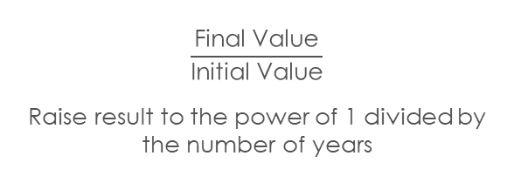
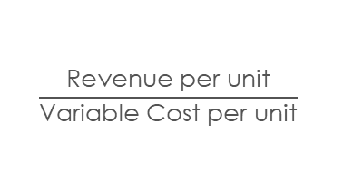
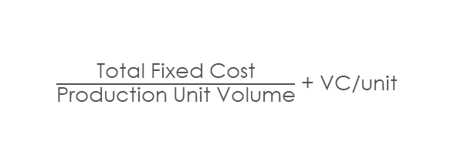
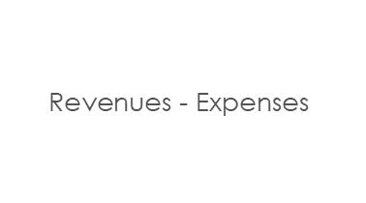
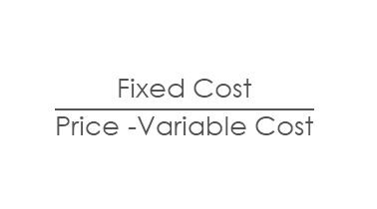
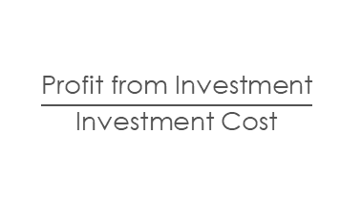
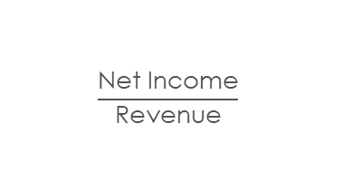
FORMULAS
Net Income
Contribution Margin
Profit Margin
ROI
$$\text{Revenues}\text{ − }\text{Expenses}$$
$$\frac{\text{Revenue} \text{per} \text{unit}}{\text{Variable} \text{Cost} \text{per} \text{unit}}$$
$$\frac{\text{Net} \text{Income}}{\text{Revenue}}$$
$$\frac{\text{Profit} \text{from} \text{Investment}}{\text{Investment} \text{Cost}}$$
Breakeven Point in Unit
Breakeven Point in Price
Compound Annual Growth Rate
$$\frac{\text{Fixed} \text{Cost}}{\text{Price}\text{ −}\text{Variable} \text{Cost}}$$
$\frac{\text{Total} \text{Fixed} \text{Cost}}{\text{Production} \text{Unit} \text{Volume}}$ + VC/unit
$$\frac{\text{Final} \text{Value}}{\text{Initial} \text{Value}}$$
Raise result to the power of 1 divided by the number of years

Slide 31
1
PROFITS & LOSS
Revenues: What are the major revenue streams, and what percentage of the total revenue does each stream represent? Does anything seem unusual in the balance of percentages? Have the percentages changed lately? If so, why?
Costs: Any major shifts in costs? Do any costs seem out of line? If we benchmarked our costs against our competitors' costs, what would we find?
2
ENTERING A NEW MARKET
Can involve mergers, acquisitions, joint ventures, starting a new business, or the development of a new product.
M&A: The two most important factors about a merger are whether it increases shareholder value and whether the two cultures will mesh well. Cultural mismatch is the biggest reason mergers fail or don't live up to their potential.
CASE TYPES
3
PRICING
Investigate the company & its objective, learn about the product or service & the competition, & then pick a pricing strategy.
Competitive Analysis, Cost-based Pricing & Price-based Costing
4
GROWING AND INCREASING SALES
Learn about the company and its size, resources, and products.
Investigate the industry: Is it growing and how is the client growing compared with the industry? Are the client's prices in line with its competitors
Growing and Increasing Sales
Learn about the company and its size, resources, and products.
(2) Investigate the industry: Is it growing and how is the client growing compared with the industry? Are the client's prices in line with its competitors?

Slide 32
BUBBLE CHART
Our Company
Competitor
Bubble Charts are typically used to compare and show the relationships between categorized circles, by the use of positioning and proportions. The overall picture of Bubble Charts can be used to analyze for patterns and correlations.
Drug Mortality Rate
Drug Efficacy Rate

Slide 33
STACKED BAR CHART
Bar charts are best used when showing comparisons between categories.
Typically, the bars are proportional to the values they represent and can be plotted either horizontally or vertically. One axis shows the specific categories being compared, and the other axis represents discrete values.

Slide 34
MARIMEKKO/MEKKO CHART
Total = $24,500
Us
Company A
Company B
100%
In a Marimekko Chart, both axes are variables with a percentage scale, that determines both the width and height of each segment. So Marimekko Charts work as a kind of two-way 100% Stacked Bar Graph.
90%
80%
70%
60%
% of Sales
50%
40%
30%
20%
10%
0%
0%
10%
20%
30%
40%
50%
60%
70%
80%
90%
100%

Slide 35
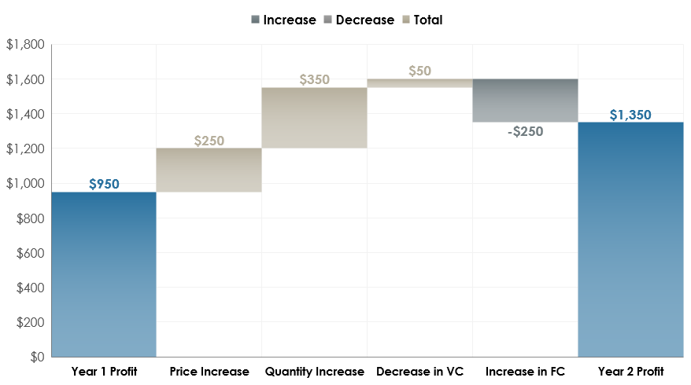
WATERFALL CHARTS
A waterfall chart shows a running total as values are added or subtracted. It's useful for understanding how an initial value (for example, net income) is affected by a series of positive and negative values. The columns are color coded so you can quickly tell positive from negative numbers.

Slide 36
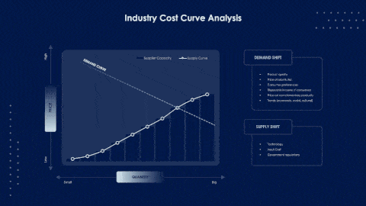


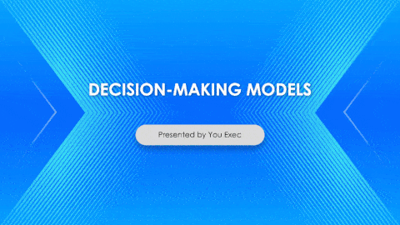
Related
The following resources are related to this framework and can save you hours of work.
If you’re a free or paid member, log into You Exec first for a better download experience.
Consulting Frameworks
Innovative Solutions
Problem-Solving Tools
Decision-Making Models

